Slide 1
Distributions and sampling: Gaussian, central limit theorem, A/B tests and temperature
Why can the same question get a different answer from a chat model, and how do we test whether a new AI feature is better?
Mathematics for AI and Machine Learning | Session 14 of 18 | Probability and statistics
KLAi Professional Learning | Jotham Martin Wambi
Notes:
Welcome to Session 14. Last time we learned the vocabulary of probability. Today we meet the shapes that data and models actually follow, and the tools to reason from a sample. We end with a question you have probably asked yourself: why does a chat model answer the same question differently each time? You will be able to answer it with arithmetic.

Slide 2



Today in one view: what you will leave with
By the end of today you can
Describe the Bernoulli, binomial and Gaussian distributions, and the multivariate Gaussian as a picture
Explain the law of large numbers, the central limit theorem, standard error and a confidence interval, and run a two-proportion A/B test
Calculate softmax with temperature and a top-p cut on toy logits, and sample the next word from the result
Notes:
Today you leave able to do three things. First, describe the Bernoulli, binomial and Gaussian distributions, and picture the multivariate Gaussian. Second, explain the law of large numbers, the central limit theorem, the standard error and a confidence interval, and run an A/B test. Third, calculate softmax with temperature and a top-p cut on toy logits, and sample a next word.
That third skill answers why a chat model can give different answers to the same question.

Slide 3
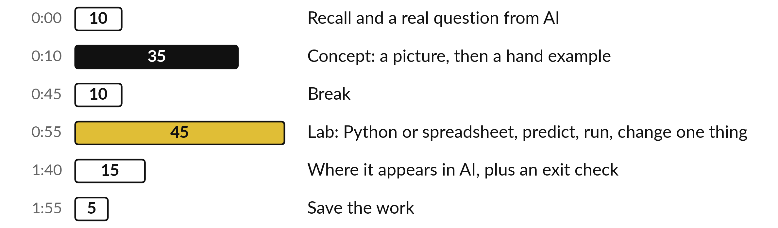
Your two hours: distributions,
tests, then sampling words
Pictures and hand calculations first. Then the lab on sampling, averages and temperature.
Notes:
The first ten minutes recall Session 13 and introduce the question about different answers. Then thirty-five minutes of concepts, with a picture first and a hand example after it. After the break you have forty-five minutes in the lab, in Python or in a spreadsheet, on the same numbers.
We finish with where this appears in AI, an exit check and saving your work.

Slide 4

Three questions from last time
1. The probabilities of all possible next words must add up to what number, and which rule says so?
2. What is the expectation of a fair die, and what does it mean?
3. What is the difference between covariance and correlation?
Answer aloud first. Then we check together.
Notes:
Three quick questions from Session 13. Answer aloud first, and then we check together. It is a warm-up to bring last time back.
Question one. The probabilities of all possible next words must add up to what number, and which rule says so? Take a moment.
A good answer is this. To 1. The total rule: all outcomes together have probability 1.
Question two. What is the expectation of a fair die, and what does it mean? Say it to yourself first.
A good answer is this. 3.5. It is the probability-weighted average over many rolls. No single roll shows it.
Question three. What is the difference between covariance and correlation? Think about your own task as you answer.
A good answer is this. Covariance has units. Correlation divides by both standard deviations, has no units and lies between -1 and +1.
If an answer was missing, do not worry. Your notes from last class have it. Now to today.

Slide 5
Answers to the three questions from Session 13
Question | Short answer
The probabilities of all possible next words must add up to what number, and which rule says so? | To 1. The total rule: all outcomes together have probability 1.
What is the expectation of a fair die, and what does it mean? | 3.5. It is the probability-weighted average over many rolls. No single roll shows it.
What is the difference between covariance and correlation? | Covariance has units. Correlation divides by both standard deviations, has no units and lies between -1 and +1.
If an answer surprised you, look back at Session 13 before the lab.
Notes:
Here are the short answers. First, the probabilities of all the possible next words add up to one, because of the total rule: all outcomes together have probability one. Second, the expectation of a fair die is 3.5. It is the weighted average over many rolls, and no single roll shows it.
Third, covariance carries the units of both columns. Correlation divides by both standard deviations, so it has no units and lies between minus one and plus one. Check your own answers against these.

Slide 6




Words we use today
Word | What it means
Gaussian (normal) distribution | The bell curve, set by its mean mu and standard deviation sigma.
Central limit theorem | Averages of many independent values are close to Gaussian, whatever the original shape.
Standard error and confidence interval | The standard deviation of a sample mean, and a range built from it that usually captures the true value.
Hypothesis test and p-value | A check of whether a gap could be luck. The p-value is the probability of seeing a gap at least this large, in either direction, if there were truly no difference.
Temperature and top-p (nucleus) sampling | Settings that reshape and trim the next-word probabilities before one word is drawn.
Notes:
Five words for today. I give the plain meaning of each, and we use every one of them before the end of the session.
Gaussian (normal) distribution. The bell curve, set by its mean mu and standard deviation sigma.
Central limit theorem. Averages of many independent values are close to Gaussian, whatever the original shape.
Standard error and confidence interval. The standard deviation of a sample mean, and a range built from it that usually captures the true value.
Hypothesis test and p-value. A check of whether a gap could be luck. The p-value is the probability of seeing a gap at least this large, in either direction, if there were truly no difference.
Temperature and top-p (nucleus) sampling. Settings that reshape and trim the next-word probabilities before one word is drawn.

Slide 7
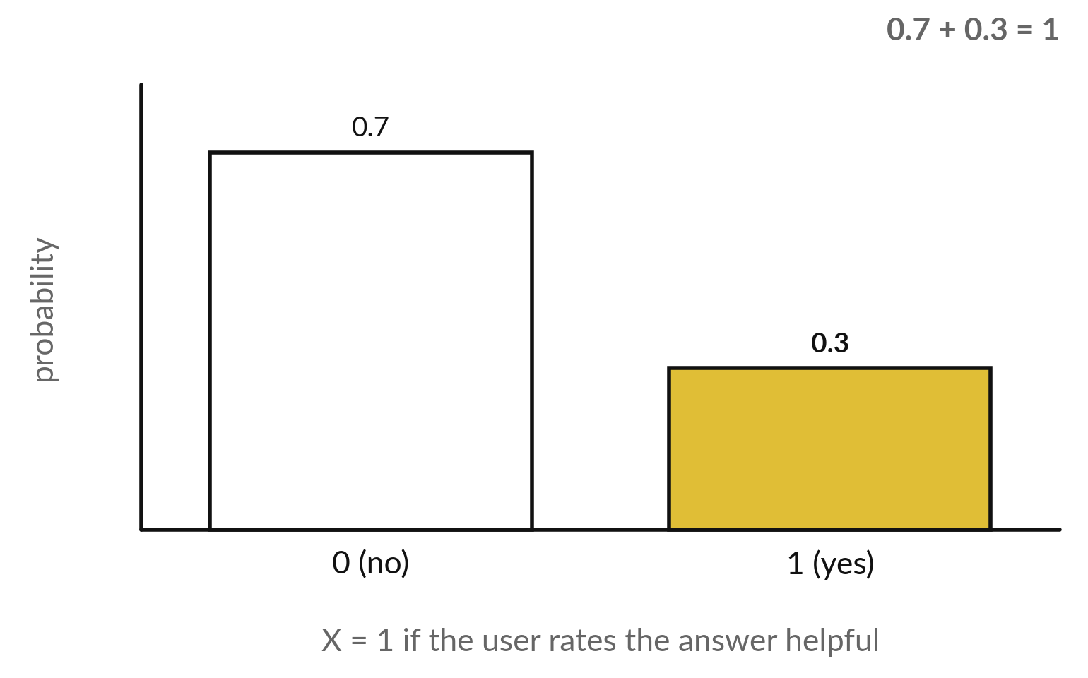
A Bernoulli random variable is one
yes or no event with probability p
Illustrative: one user rates an answer helpful with probability p = 0.3.
Bernoulli(p): X is 1 with probability p and 0 with probability 1 - p.
E(X) = p = 0.3.
Var(X) = p(1 - p) = 0.21.
Notes:
The simplest random variable has only two outcomes, yes or no. We call it a Bernoulli random variable. It equals one with probability p and zero with probability one minus p. Here is an illustrative example: a user rates a chat answer as helpful with probability 0.3. The expectation is simply p, 0.3, and the variance is p times one minus p, which is 0.21.
A coin flip, a spam or not spam label and a fault or no fault reading are all Bernoulli variables. Which one have you met in your own work?

Slide 8
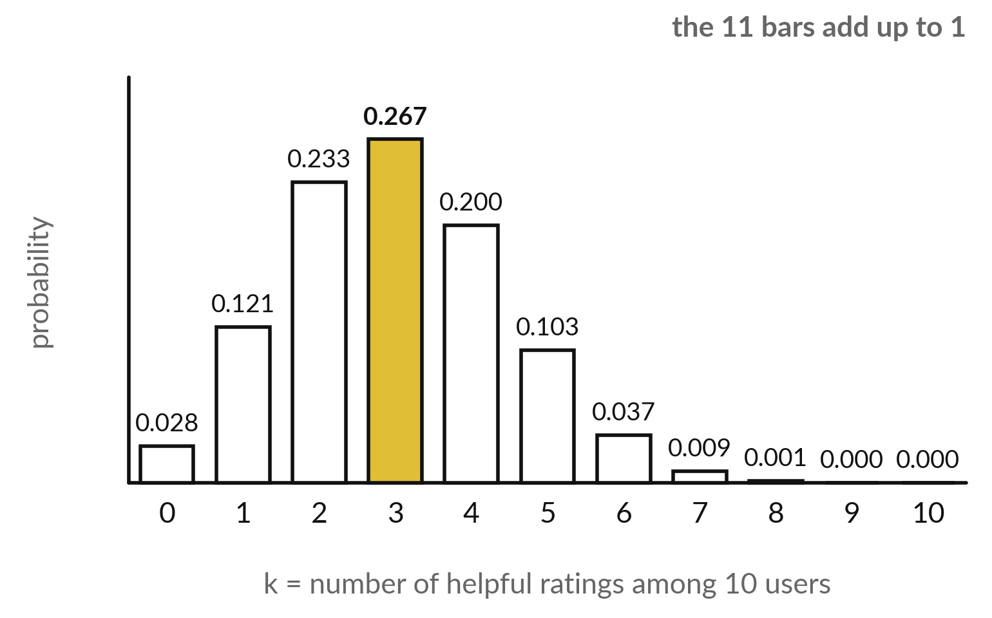
A binomial random variable counts the
successes in n independent Bernoulli trials
Ten users, each rates helpful with p = 0.3 (illustrative). X counts the helpful ratings.
P(X = 3) = 0.2668, the gold bar.
Mean n p = 3. Standard deviation = 1.449.
Binomial(n, p) has a mass function with n + 1 bars.
Notes:
Now repeat the Bernoulli trial n times independently, and count the successes. That count is a binomial random variable. Here ten users each rate helpful with probability 0.3. The bars show how likely each count is, from zero up to ten. Three helpful ratings is the most likely, which makes sense because the mean is n times p, which is three.
The gold bar is the probability of exactly three: 0.2668. The bars add up to one, as every pmf must. Which count is least likely?

Slide 9
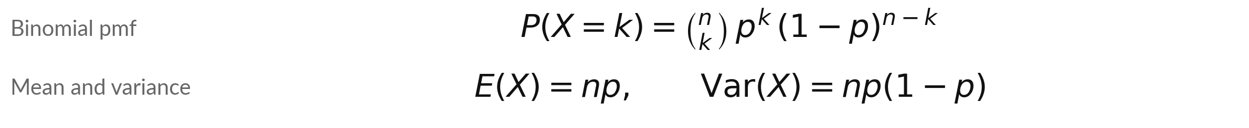
The binomial formula counts the
ways and multiplies the probabilities
Symbol | What it means | In our data
n choose k | The number of ways to place k successes among n trials: n! / (k! (n-k)!). | 10 choose 3 = 120
p to the k | Probability that k trials all succeed. | 0.3 cubed = 0.027
(1-p) to the n-k | Probability that the other n - k trials all fail. | 0.7 to the 7 = 0.08235
P(X = 3) | Multiply the three parts. | 120 × 0.027 × 0.08235 = 0.2668
Spreadsheet: BINOM.DIST(3, 10, 0.3, FALSE) gives the same number. TRUE gives P(X at most 3).
Notes:
Here is the formula. The first part, n choose k, counts the ways to choose which k of the n trials succeed. For ten trials and three successes there are 120 ways. The next part is the probability that those three succeed, 0.3 cubed. The last is the probability that the other seven fail, 0.7 to the power seven.
Multiply the three parts and you get 0.2668. The mean is n times p and the variance is n times p times one minus p. In a spreadsheet, BINOM.DIST does the same arithmetic, and in the lab you check it.

Slide 10
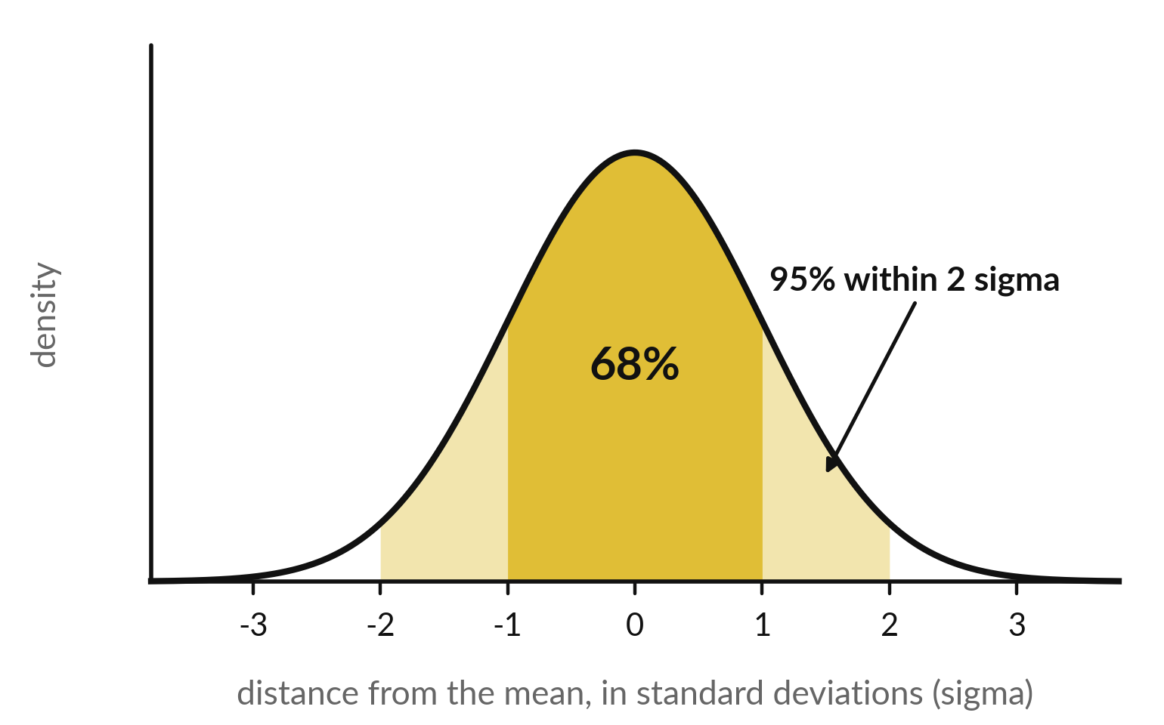
The Gaussian (normal) distribution is the bell
curve set by its mean and standard deviation
Gaussian (normal) distribution: symmetric, centred on the mean mu, with width set by sigma.
About 68% of values lie within 1 sigma of mu, and about 95% within 2 sigma.
Averages and sums of many small effects look Gaussian. The central limit theorem says why.
Notes:
This is the most important shape in statistics, the Gaussian, also called the normal distribution. It is a symmetric bell, centred on the mean mu, and its width is the standard deviation sigma. The horizontal axis counts distance from the mean in standard deviations. About 68 percent of values lie within one sigma of the mean, the dark gold area.
About 95 percent lie within two sigma. Real data is never perfectly Gaussian, but the shape is a good model for many measurements, and soon you will see why averages follow it.

Slide 11
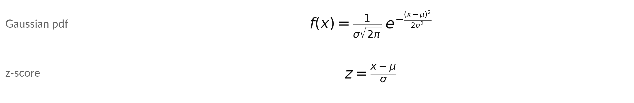
The Gaussian density and the z-score
Symbol | What it means | In our data
mu, sigma | Mean and standard deviation. Quiz scores (illustrative). | mu = 60, sigma = 10
z | How many standard deviations x lies above the mean. | x = 75 gives z = 1.5
Areas | P(X < 75) is the area left of z = 1.5. P(50 < X < 70) is the area between z = -1 and 1. | 0.9332 and 0.6827
No integrating by hand: NORM.DIST in a sheet or math.erf in Python gives the areas.
Notes:
Here are the formulas. The density has the mean and the standard deviation in it, but the shape is always the same bell. The z-score tells us how many standard deviations a value is above the mean. Take illustrative quiz scores with mean 60 and standard deviation 10.
A score of 75 has z equal to 1.5. The area to its left is 0.9332, so about 93 percent of learners score below 75. Between 50 and 70, within one sigma, the area is 0.6827. You get these areas from NORM.DIST in a spreadsheet, so nobody integrates by hand.

Slide 12
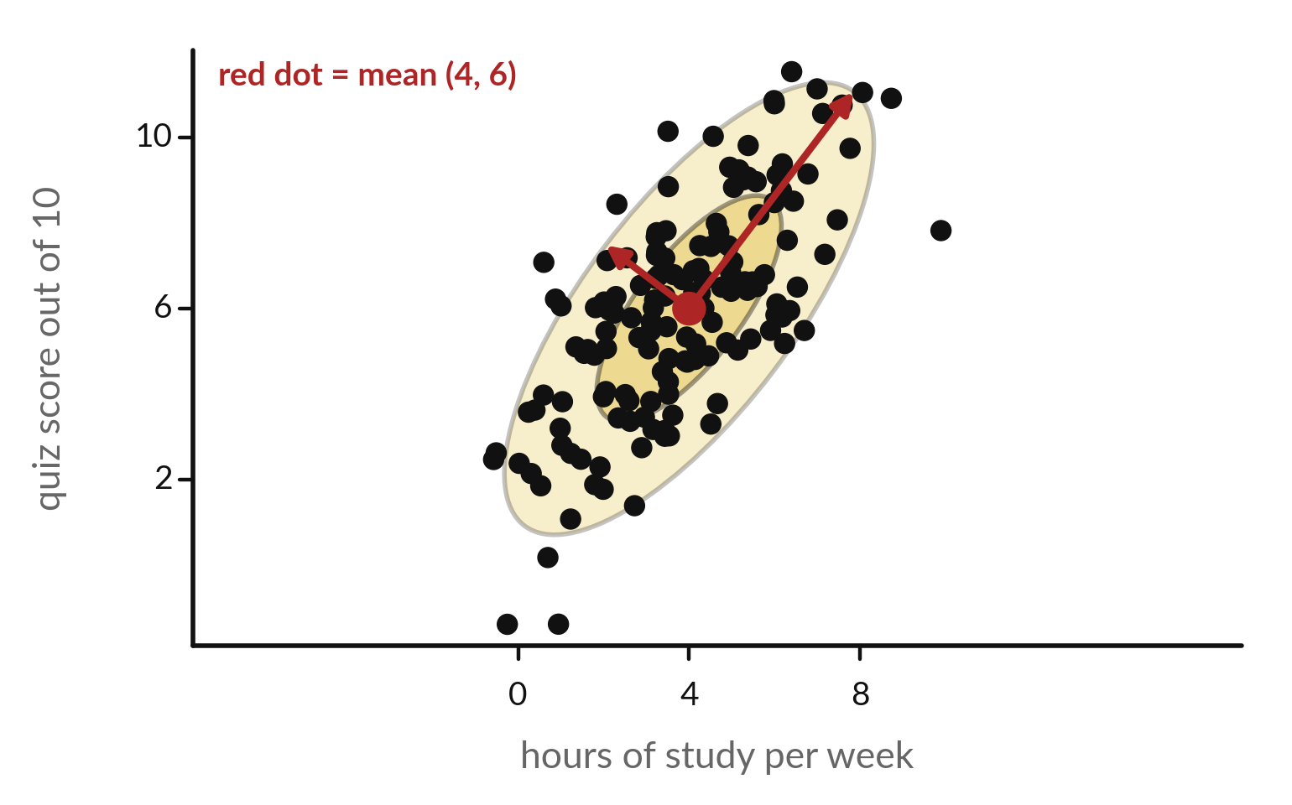
A multivariate Gaussian is a cloud
with a centre and a tilted ellipse
Two columns at once: study hours and score from Session 13 (illustrative). 150 simulated points.
Centre: the means, 4 and 6.
Ellipses: 1 and 2 standard deviations.
Red arrow = eigenvector of the covariance matrix, along an ellipse axis. Its eigenvalue is the variance along it.
Notes:
Real data has many columns, so we need the Gaussian in several dimensions. Picture two columns, study hours and score. The multivariate Gaussian is a cloud of points. Its centre is the vector of the two means. Its shape is an ellipse, and the tilt of the ellipse comes from the covariance.
If the columns rise together, the ellipse leans up to the right. The red arrows are the eigenvectors of the covariance matrix, along the long and short axes. That is exactly the idea behind PCA from Session 6. The points here are simulated from our six-learner statistics.

Slide 13
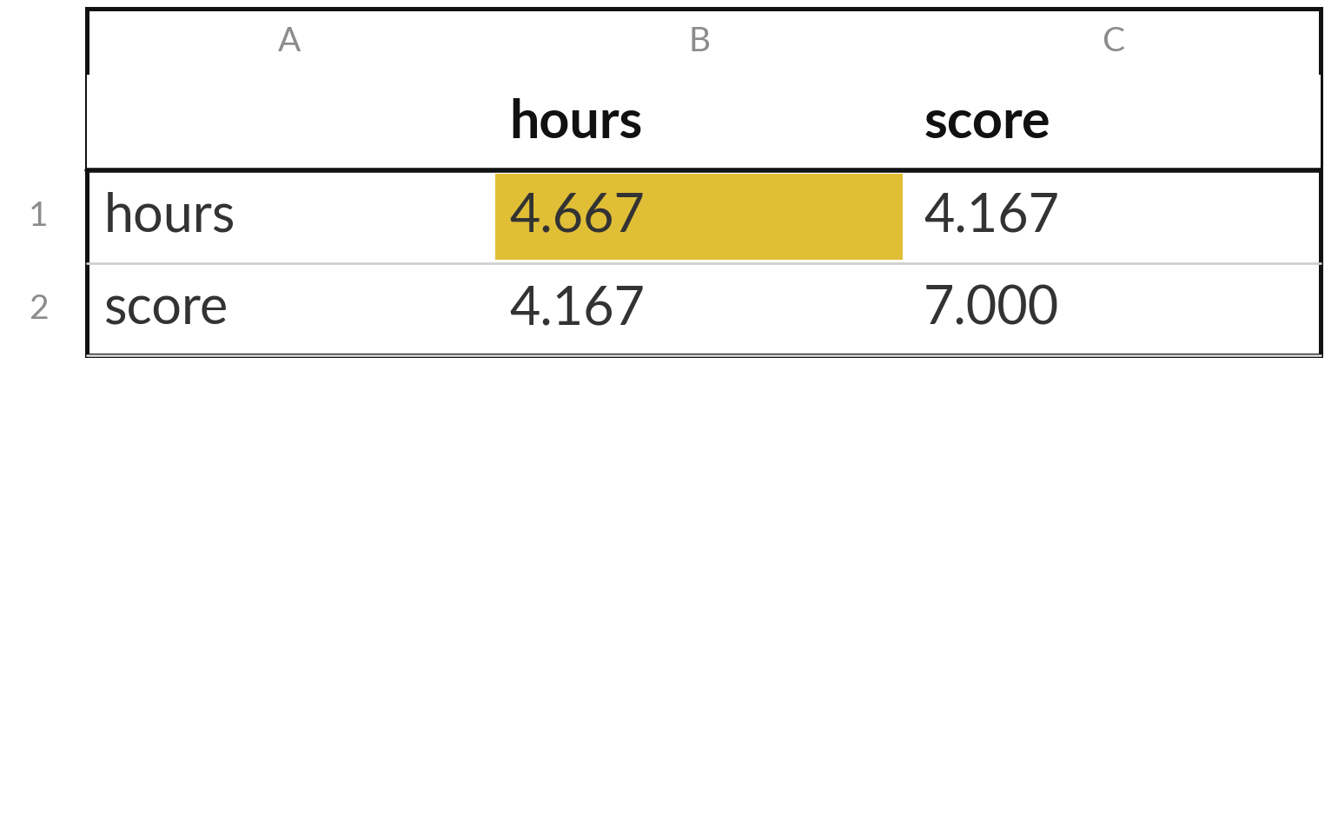
The covariance matrix puts every
variance and covariance in one table
The covariance matrix of the two columns from Session 13 (this course divides by n).
Diagonal: the variances 4.667 and 7.
Off the diagonal: the covariance 4.167, twice.
Its eigenvalues are 10.160 and 1.506: the ellipse is long in one direction and thin in the other.
Notes:
For many columns we collect all the variances and covariances in one square table, the covariance matrix, usually written capital sigma. The variances sit on the diagonal. The covariance between each pair of columns sits off the diagonal, and the table is symmetric. For our two columns the diagonal holds 4.667 and 7, and the covariance is 4.167.
The eigenvalues of this matrix are 10.160 and 1.506. A big gap between them means a long, thin ellipse. Multivariate Gaussians are described by a mean vector and this matrix.

Slide 14
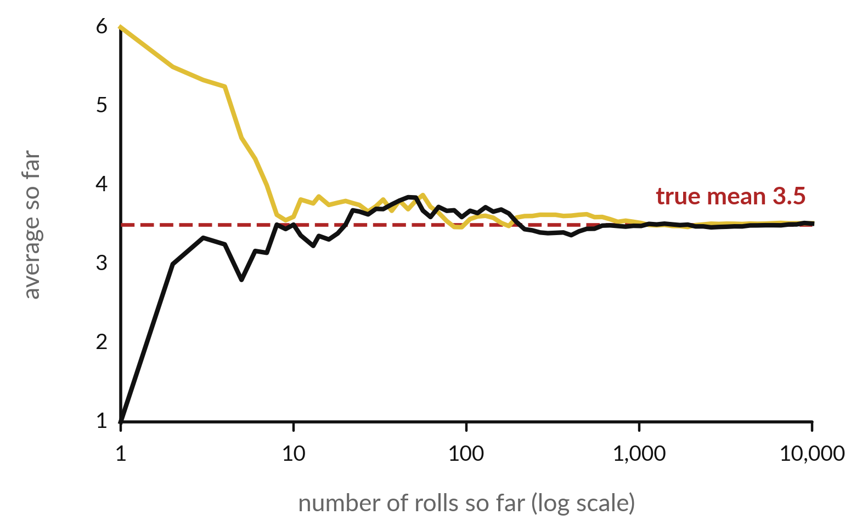
The law of large numbers: the more repeats,
the closer the average gets to the true mean
Two runs of rolling a die 10,000 times (simulation). The line is the running average.
After 1 roll the average is one of 1 to 6, often far from 3.5.
After 100 rolls it is near 3.5.
After 10,000 rolls it is usually within about 0.03 of 3.5.
Notes:
The law of large numbers says that the more repeats you average, the closer the average gets to the true mean. Here are two simulated runs of rolling a die ten thousand times. The horizontal axis is logarithmic, so the early rolls get room. After a single roll the average is just that one roll, any of one to six, so it is often far off.
In these two runs it started at one and at six. By a hundred rolls both lines are near 3.5, and by ten thousand they are very close. Remember our sixty fixed rolls from Session 13, with a mean of 3.97. Sixty is simply too few to settle.

Slide 15
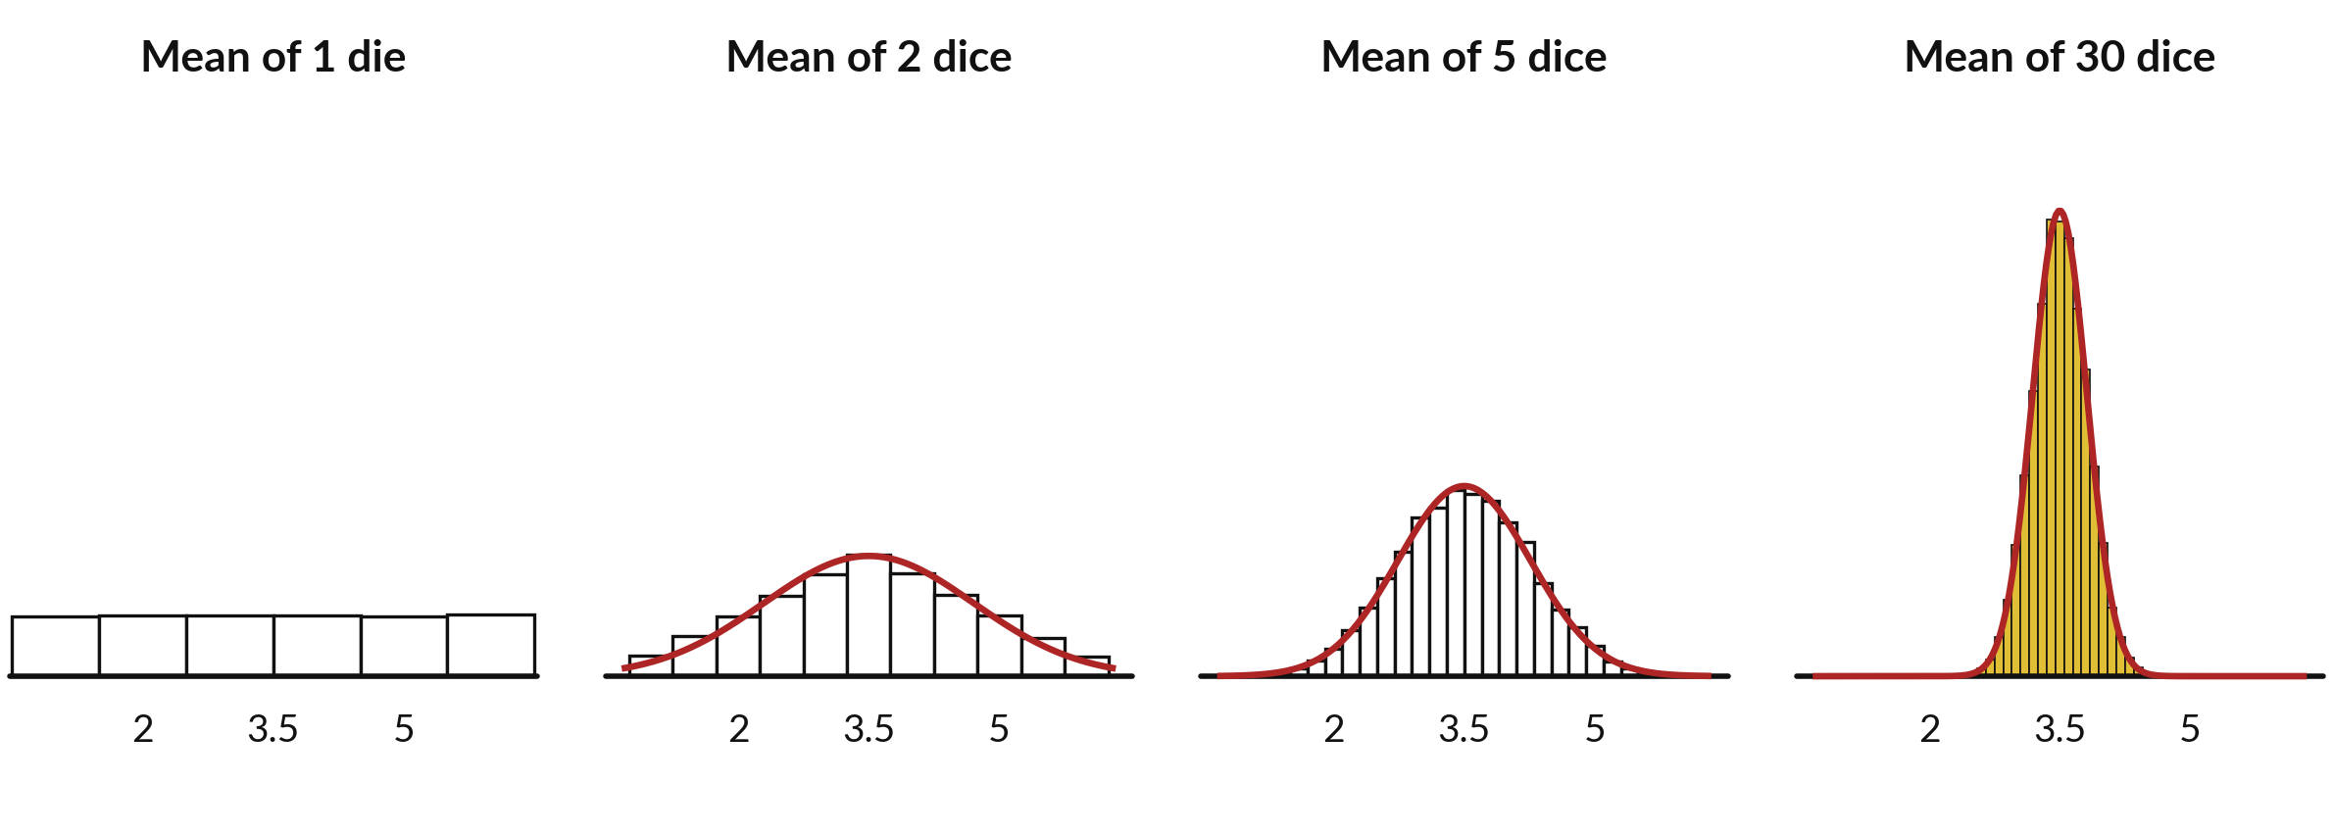
The central limit theorem: averages of many
rolls look Gaussian, though a single die is flat
Each panel: 20,000 averages of n dice. n = 1 is flat, not Gaussian. At n = 30 the red curve fits.
Notes:
Here is the central limit theorem as a picture. Each panel shows twenty thousand averages. On the left, the average of one die is just a die, flat, with six bars. The average of two dice is a triangle. With five dice the shape is already a bell.
With thirty dice it is almost exactly the red Gaussian curve, and it is also much narrower. The theorem says this happens for averages of independent values from almost any starting shape, as long as there are enough of them. That is why the Gaussian appears everywhere. Why is the last panel so much narrower?

Slide 16
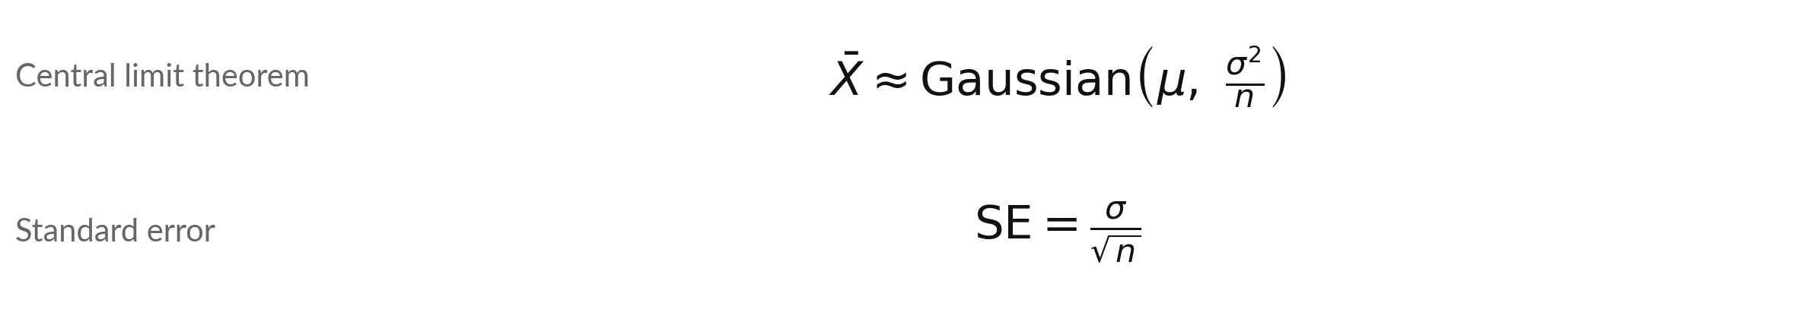
Standard error: how much a sample mean wanders
Symbol | What it means | In our data
x-bar | The mean of a sample of n values. | mean of 30 dice
sigma, n | Standard deviation of one value, and the sample size. | sigma = 1.7078 for a die
SE | Standard error: the standard deviation of the sample mean. | 1.7078 / sqrt(30) = 0.3118
Four times the data halves the SE. Simulated 30-dice averages (seed 14): standard deviation 0.311.
Notes:
Here is what the picture says in formulas. The mean of n independent values is close to Gaussian, centred on the true mean mu, with variance sigma squared over n. The standard deviation of the sample mean is called the standard error, sigma over the square root of n.
For thirty dice, 1.7078 divided by the square root of thirty is 0.3118, and the simulation gave 0.311. Notice the square root. To halve the standard error you need four times the data. For a proportion the standard error uses p hat times one minus p hat.

Slide 17
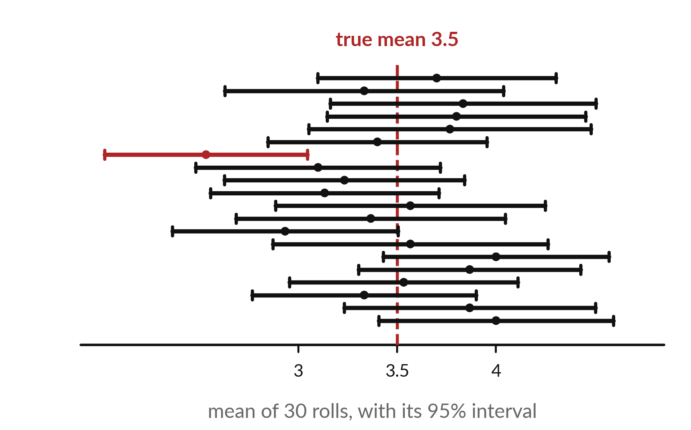
A 95% confidence interval comes from a method that
catches the true mean in about 95 of 100 samples
20 samples of 30 dice (simulation). 19 of the 20 intervals contain the true mean 3.5. The red one misses.
Interval = sample mean plus or minus 1.96 standard errors.
The 95% describes the method over many samples.
It is not the chance that this one interval holds the true value.
Notes:
A confidence interval gives a range for the true mean instead of a single guess. For each sample of thirty dice we compute the mean, and then go 1.96 standard errors to each side. Here are twenty samples. 19 of the twenty intervals catch the true mean, 3.5.
The red one misses. That matches the promise: about 95 out of 100 intervals catch it. But be careful with the wording. The ninety-five percent describes the method over many samples. Once an interval is computed, the true mean is either inside or outside it.

Slide 18
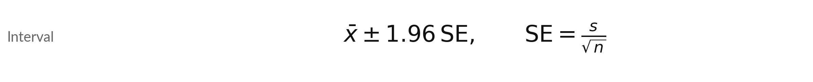
Confidence interval for a mean,
worked on the 60 fixed rolls
Symbol | What it means | In our data
x-bar, n | The mean of the 60 rolls from Session 13, and the sample size. | 3.9667, 60
s | The sample standard deviation (divides by n - 1). | 1.7847
SE | Standard error s over the square root of n. | 0.2304
Interval | Mean plus or minus 1.96 SE. | 3.515 to 4.418
1.96 is the normal approximation. With n = 60 the t value 2.00 gives 3.506 to 4.428, and 3.5 is still just outside.
Notes:
Let us compute an interval by hand. Our sixty fixed rolls had a mean of 3.9667. The sample standard deviation, dividing by n minus one, is 1.7847. The standard error is that divided by the square root of sixty, which is 0.2304. The interval is the mean plus or minus 1.96 standard errors, from 3.515 to 4.418.
Notice that 3.5 is just outside. We know the true mean is 3.5, so this sample is one of the roughly one in twenty that misses. In real work we never know the truth, which is why we report the interval. One refinement: 1.96 is the normal approximation.
With only 60 rolls a statistician would use the t value, 2.00, and the interval becomes 3.506 to 4.428, so 3.5 is still just outside.

Slide 19
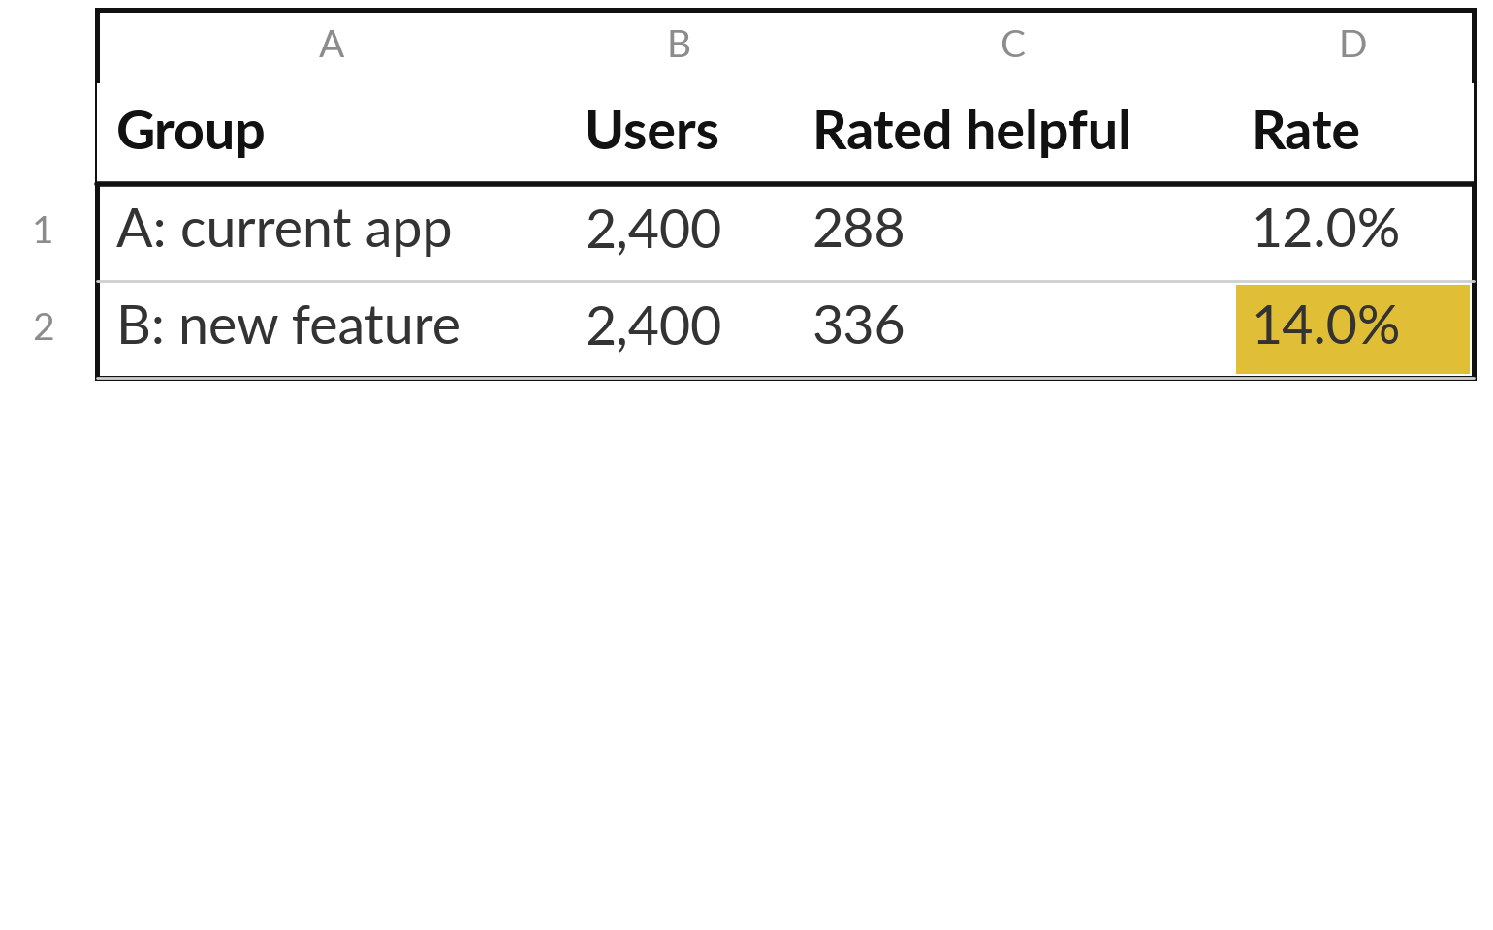
An A/B test splits users at random into
two groups and compares one rate
Illustrative counts: a new suggested follow-up feature in an AI chat app. Metric: share of chats rated helpful.
Random assignment makes the groups alike, apart from the feature.
B beats A by 2.0 percentage points.
Question: a real effect, or luck?
Notes:
Now to a decision you may face. A team adds a new feature to an AI chat app, suggested follow-up questions, and wants to know if it helps. They split users at random into group A with the current app and group B with the new feature, then count chats rated helpful.
These counts are illustrative. A had 288 of 2,400, which is 12.0%. B had 336 of 2,400, which is 14.0%. The gap is 2.0 percentage points. Is that a real effect, or could it be luck? That is what a hypothesis test answers.

Slide 20
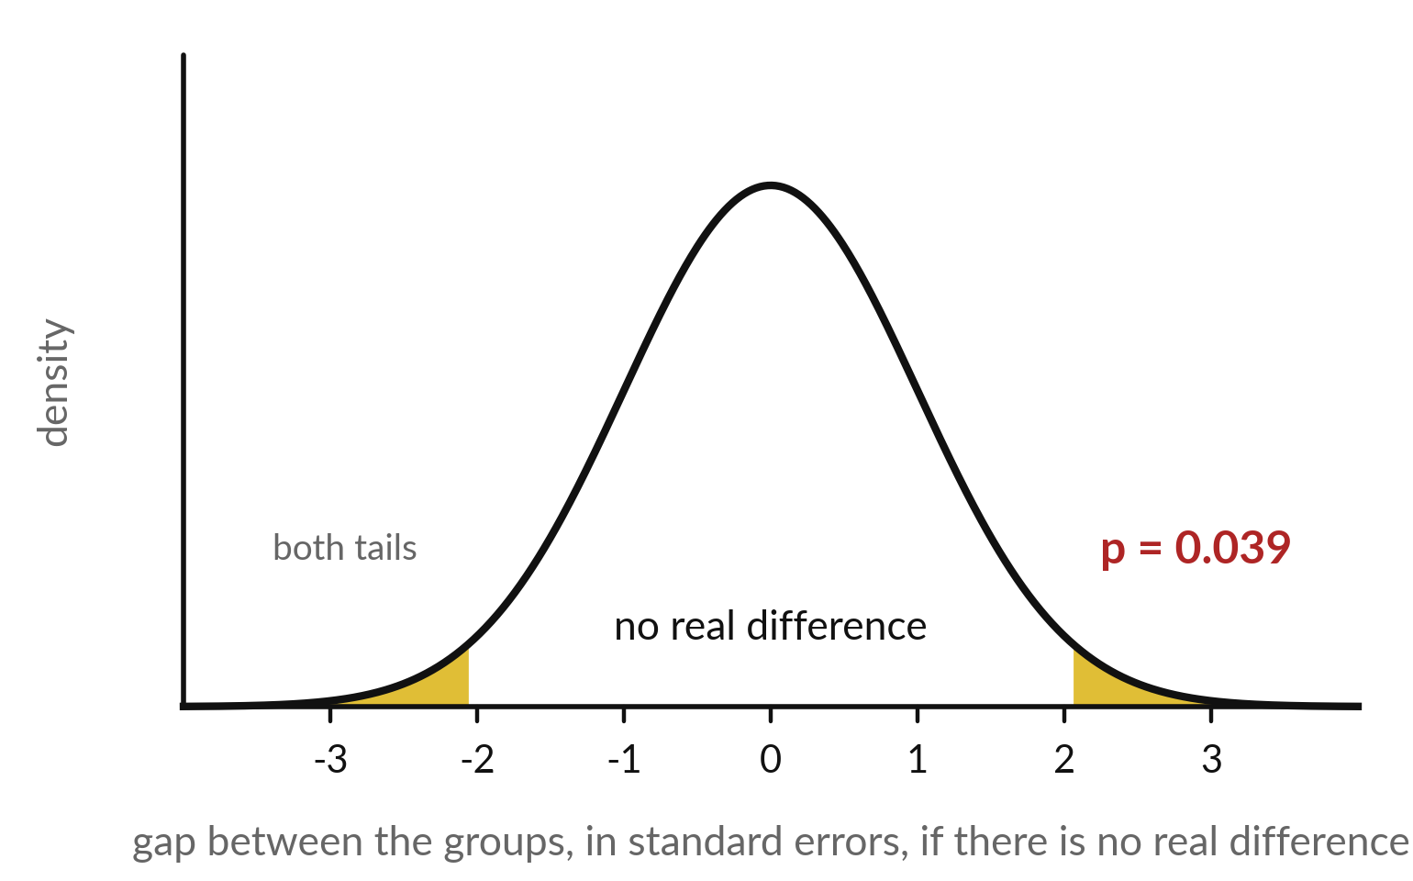
A hypothesis test asks how likely a gap this
large would be if the feature did nothing
Null hypothesis: the true rates are equal. Our gap is z = 2.06 standard errors.
The gold tails hold gaps at least this large, in either direction.
Their total area is the p-value: 0.039.
Small p-value: this gap would be rare by luck alone.
Notes:
A hypothesis test starts from a sceptical assumption, the null hypothesis, which says the two true rates are equal. If that were true, the gap between the groups would still wobble by chance, following this bell curve, measured in standard errors. Our actual gap sits at z equal to 2.06.
The gold tails show the probability of a gap at least that large in either direction. That area is the p-value, 0.039. A small p-value means: if the feature did nothing, a gap this big would be rare. It does not say how big the effect is.

Slide 21
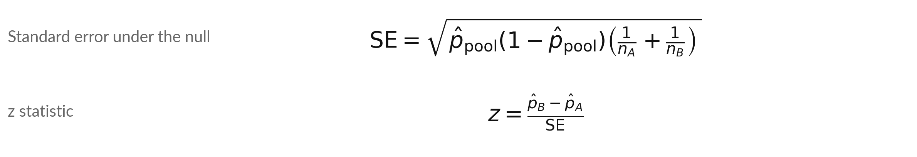
The two-proportion z-test
Symbol | What it means | In our data
p-hat_A, p-hat_B | The rate in each group: helpful chats k divided by users n. | 288 / 2400 = 0.12, 336 / 2400 = 0.14
p-hat_pool | The pooled rate: (k_A + k_B) / (n_A + n_B), both groups together. | 0.130
SE and z | The standard error of the gap, and the gap in standard errors. | 0.00971 and 2.060
Two-sided p-value = 2 × (1 - area to the left of z) = 0.0394. Spreadsheet: 2*(1-NORM.DIST(z,0,1,TRUE)).
Notes:
Here is the test. If the null hypothesis is true, both groups share one rate, so we pool the counts: 624 helpful chats out of 4,800, which is 0.13. The standard error of the gap uses that pooled rate and both sample sizes, and it comes to 0.00971.
The z statistic is the observed gap divided by the standard error, 2.060. The two-sided p-value is twice the area beyond z, which is 0.0394. Next we put every step in one table.

Slide 22
The A/B test step by step,
with a 95% interval for the gap
Step | Calculation | Result
1 Rates | 288 / 2400 and 336 / 2400 | 0.120 and 0.140
2 Pooled rate | (288 + 336) / (2400 + 2400) | 0.130
3 Standard error | square root of 0.13 × 0.87 × (1/2400 + 1/2400) | 0.00971
4 z statistic | 0.020 / 0.00971 | 2.060
5 p-value | 2 × (1 - area to the left of z) | 0.0394
6 Interval for the gap | 0.020 plus or minus 1.96 × 0.00970 | 0.0010 to 0.0390
Step 3 pools because the test assumes no difference. Step 6 does not assume that: SE = sqrt(p_A(1-p_A)/n_A + p_B(1-p_B)/n_B). The interval, 0.1 to 3.9 points, only just excludes 0.
Notes:
Here is the whole test in one table, with illustrative counts. Step one, the two rates. Step two, the pooled rate, 0.13. Step three, the standard error of the gap. Step four, z equals 2.06. Step five, the p-value, 0.0394. And step six, a confidence interval for the gap itself: from 0.1 to 3.9 percentage points.
The interval only just excludes zero. That is more informative than the p-value alone, because it shows the effect could be tiny. A careful team might run the test longer.

Slide 23


A p-value is easy to misread
A p-value is
A p-value is not
The probability of a gap at least this large, either way, if there were truly no difference
The probability that the feature does nothing
The size of the effect
Proof: test 20 useless features and about 1 passes at p < 0.05 by luck
Report the gap and its interval beside the p-value.
Notes:
Here is the warning. A p-value is the probability of seeing a gap at least this large, in either direction, if there were truly no difference. That is all. It is not the probability that the feature does nothing, and it says nothing about how big or how useful the effect is.
A tiny effect can have a tiny p-value with enough users. And if you run twenty tests, one will pass the 0.05 line by luck alone. So always report the gap and its interval next to the p-value. What would you want to see before shipping the feature?

Slide 24
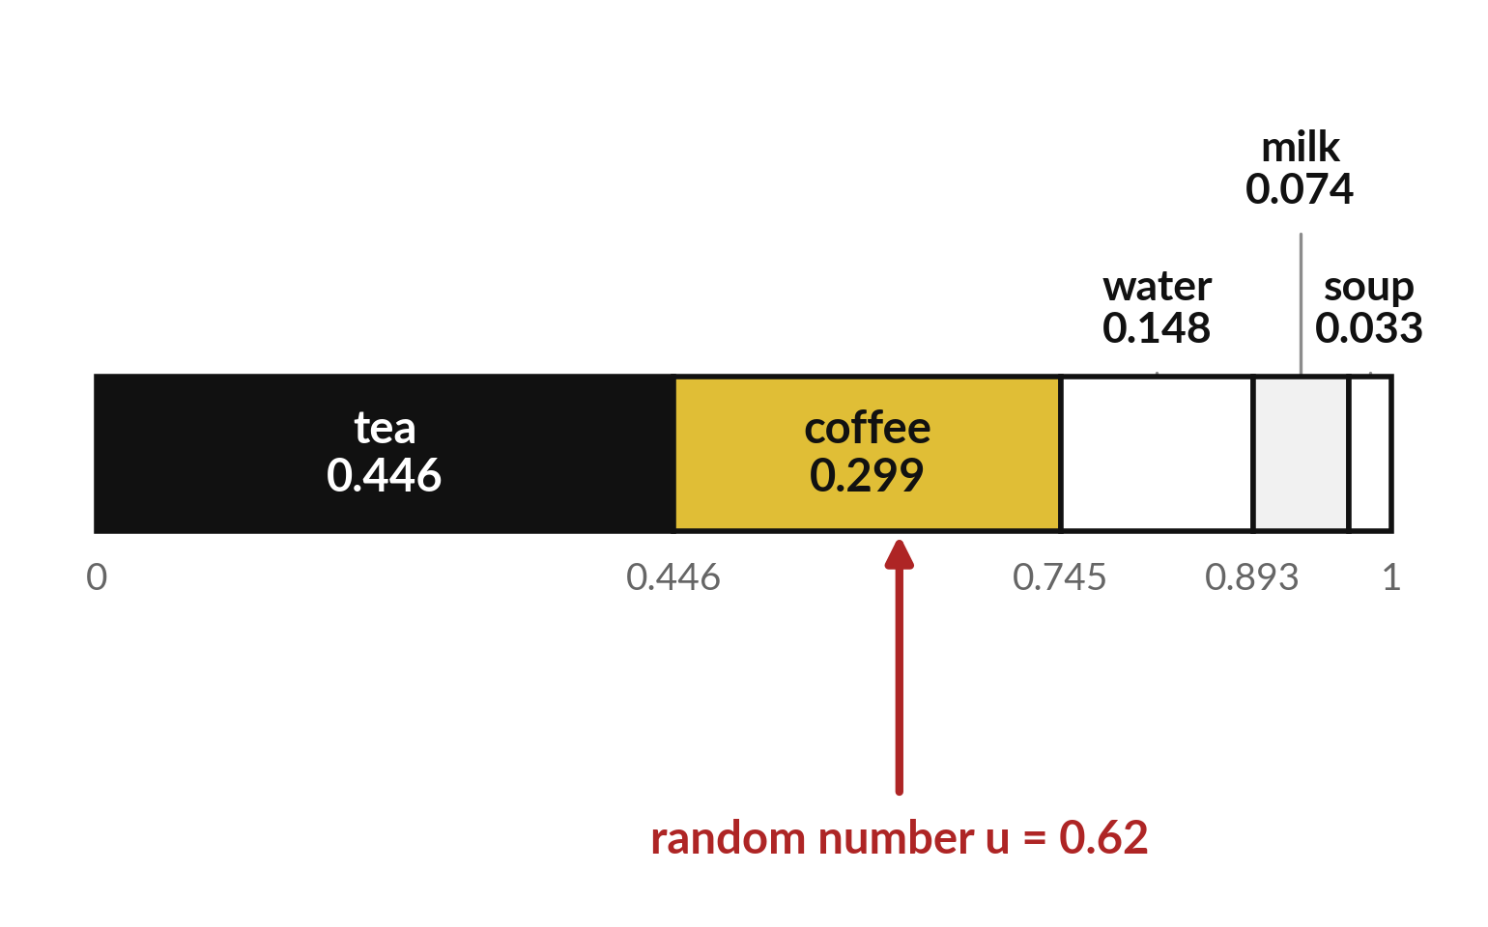
Sampling from a distribution: cut 0 to 1 into
slices and see where a random number lands
Each word owns a slice as wide as its probability. Draw a random number u between 0 and 1.
u = 0.62 lands in the coffee slice (0.446 to 0.745).
Draw again and u differs, so the word can differ.
Likely words are picked often, unlikely ones sometimes.
Notes:
How does a program pick a word from a probability list?
It cuts the line from zero to one into slices, one per word, as wide as each probability. Tea owns the first 0.446, coffee the next 0.299, and so on. Then it draws a random number between zero and one. Here u is 0.62, which falls in the coffee slice, between 0.446 and 0.745.
So the program outputs coffee. Draw again, and u will be different, so the word can be different. This is why the same question can give different answers. The numbers here are illustrative.

Slide 25
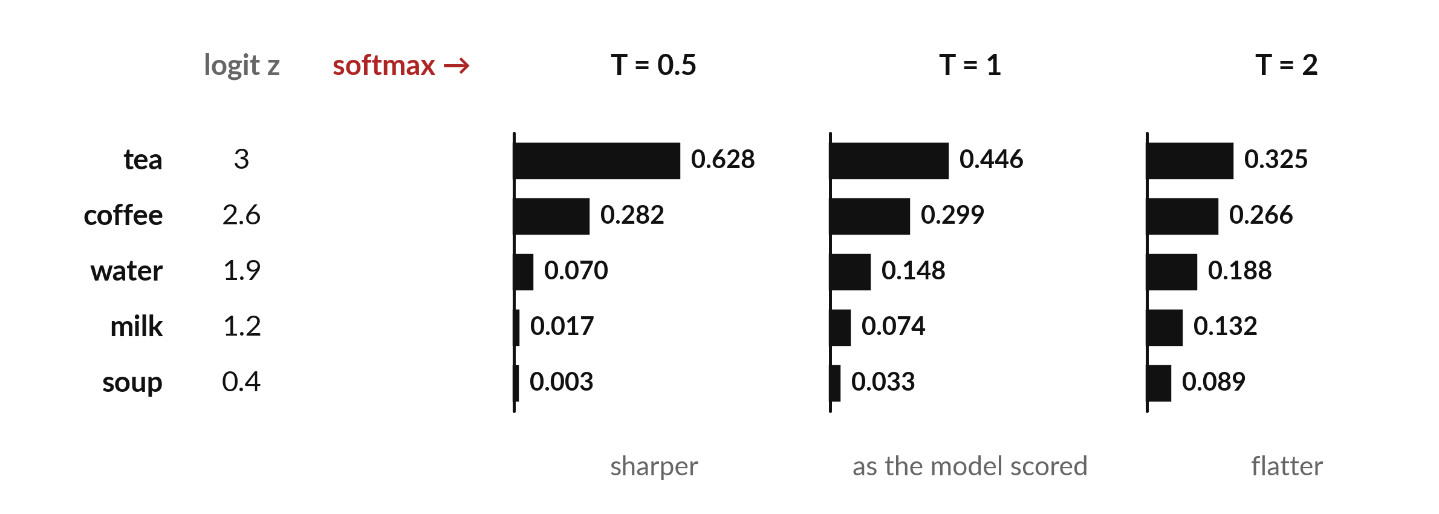
Temperature reshapes the
probabilities: low is sharp, high is flat
Illustrative logits. Same five words, three temperatures. Each column of probabilities adds up to 1.
Notes:
Temperature is a setting that reshapes the probabilities before sampling. Take the same five logits, and divide them by T before softmax. With T equal to 0.5, the top word tea jumps to 0.628 and the unlikely words nearly vanish. With T equal to one, we get the probabilities as the model scored them.
With T equal to two, the list flattens, and soup grows from 0.033 to 0.089. Low temperature gives predictable answers. High temperature gives more varied, and sometimes stranger, answers. All the numbers are illustrative.

Slide 26

Softmax with temperature
Symbol | What it means | In our data
z_i | The logit (raw score) of word i. | tea: z = 3.0
T | The temperature, above 0. T = 1 is the plain softmax. | T = 2
Worked | tea at T = 2: e to the 1.5 = 4.482. The five terms add up to 13.780. | 4.482 / 13.780 = 0.3252
Limits | T near 0 always picks the top word (greedy). T very large makes every word equally likely. | T = 0.5 gives tea 0.628
Use the stable softmax of Session 12: subtract the largest z first. The result is the same.
Notes:
Here is the formula. Divide each logit by the temperature T, take e to that power, and divide by the sum over all words. With T equal to one it is the ordinary softmax from Session 12. Worked example for tea at T equal to two. Three divided by two is 1.5, e to the 1.5 is 4.482.
The five terms add up to 13.780, so the probability is 0.3252. As T goes toward zero, the top word takes everything, which is called greedy decoding. As T grows, all words approach equal probability. Use the stable version to avoid overflow.

Slide 27
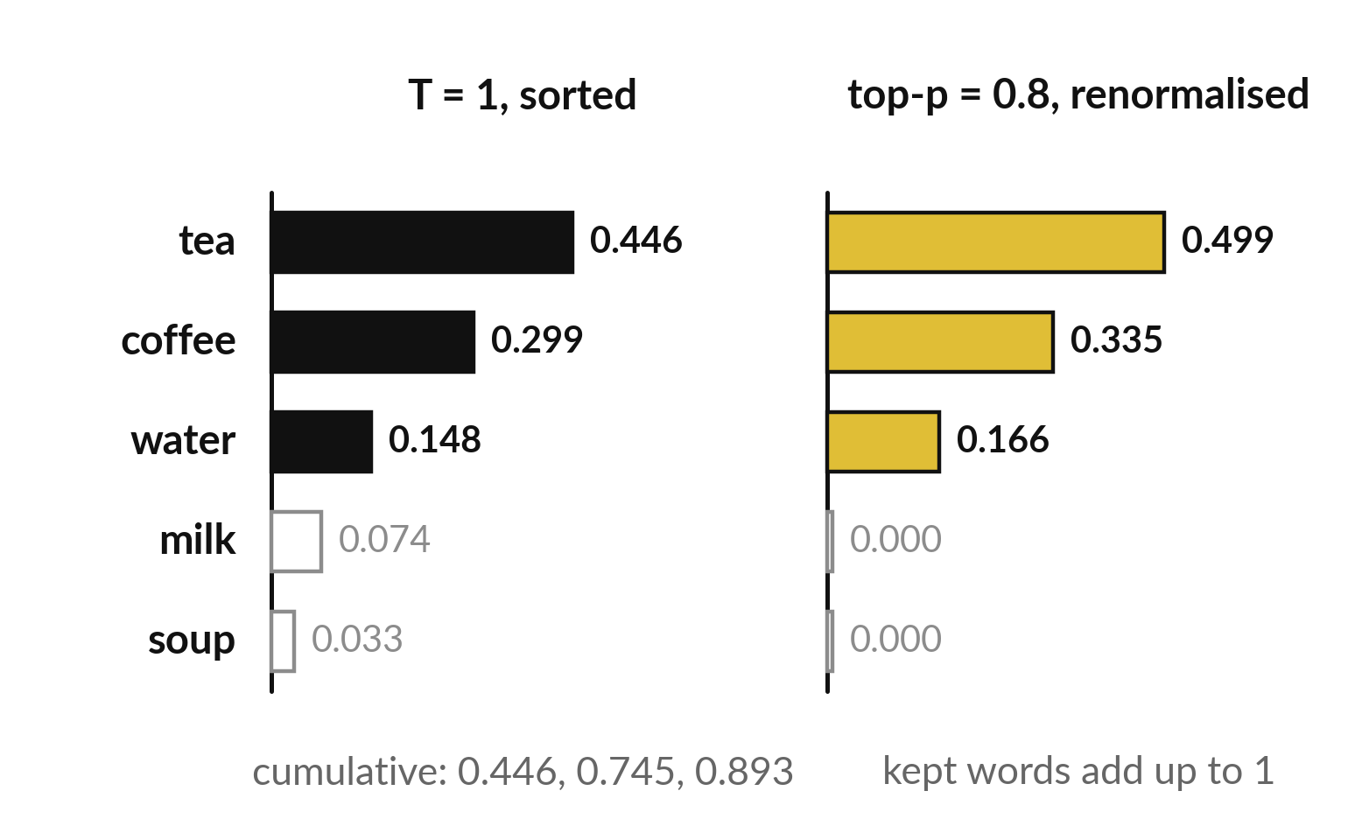
Top-p (nucleus) sampling keeps only the
smallest set of likely words, then renormalises
Top-p (nucleus) sampling with p = 0.8: add words from the most likely until the total reaches 0.8.
Tea, coffee and water reach 0.893. Milk and soup are cut (grey).
Divide the kept words by 0.893: 0.499, 0.335, 0.166.
Now milk and soup can never be chosen.
Notes:
Top-p sampling, also called nucleus sampling, was published by Holtzman and colleagues in 2020. It cuts the unlikely tail. Sort the words from most to least likely and add the probabilities until the total reaches p. With p equal to 0.8, tea gives 0.446, coffee brings it to 0.745, and water brings it to 0.893, so we stop.
Milk and soup are cut. We then divide the kept probabilities by 0.893 so that they add up to one again: tea 0.499, coffee 0.335, water 0.166. Sampling now happens only among those three. The numbers are illustrative.

Slide 28
The same eight random numbers give
different words at different temperatures
Draw | Random number u | T = 1 | T = 0.5 | T = 2
1 | 0.420 | tea | tea | coffee
2 | 0.926 | milk | water | soup
3 | 0.274 | tea | tea | tea
4 | 0.060 | tea | tea | tea
5 | 0.311 | tea | tea | tea
6 | 0.718 | coffee | coffee | water
7 | 0.781 | water | coffee | milk
8 | 0.539 | coffee | tea | coffee
Each word is the first slice whose running total reaches u. Illustrative probabilities, seed 19.
Notes:
Let us draw eight times, using the same eight random numbers for each temperature. At T equal to one the draws give 4 different words, with tea 4 times. At T equal to 0.5 the same numbers give only 3 different words, and tea 5 times, because the top slices are bigger.
At T equal to two all 5 words appear and tea only 3 times. So the same question can give different answers for two reasons. The random number changes from draw to draw, and the temperature changes how the line is cut. With a very low temperature the answers repeat.

Slide 29
Bridge: sample the central limit theorem
and the next word with NumPy
In plain words
rng = np.random.default_rng(14)
means = rng.integers(1, 7, (20000, 30)).mean(axis=1)
means.mean(), means.std()
z = np.array([3.0, 2.6, 1.9, 1.2, 0.4])
p = np.exp(z / 0.5 - (z / 0.5).max())
p = p / p.sum()
rng.choice(5, p=p)
Line 2: 20,000 samples of 30 dice. mean(axis=1) averages each row.
Line 3: the mean is near 3.5 and the standard deviation near the standard error 0.3118 (0.311 with seed 14).
Lines 4 to 6: softmax with temperature T = 0.5, stable version.
Line 7: draw one index from 0 to 4 with these probabilities.
Spreadsheet: NORM.DIST, BINOM.DIST and fixed sample columns replace the random draws.
Notes:
Here is the code you will use. The first block repeats the central limit theorem experiment. Generate twenty thousand rows of thirty dice, average each row, and look at the mean and standard deviation of those averages. The second block is softmax with temperature. Divide the logits by T, subtract the maximum for stability, exponentiate and divide by the sum.
Then rng.choice draws one word index using those probabilities. In the spreadsheet we avoid random draws and use fixed columns, so the numbers do not move.

Slide 30
Part 2: the lab
Close the slides. Open the notebook or the workbook.
Notes:
That is the end of the concepts. Please open either the Python notebook or the spreadsheet workbook. Both use the same numbers. In each step, predict first, then run, then read the output, then change one thing. In the spreadsheet we use fixed sample columns instead of the volatile RAND function, so your numbers match mine. I will walk around.

Slide 31
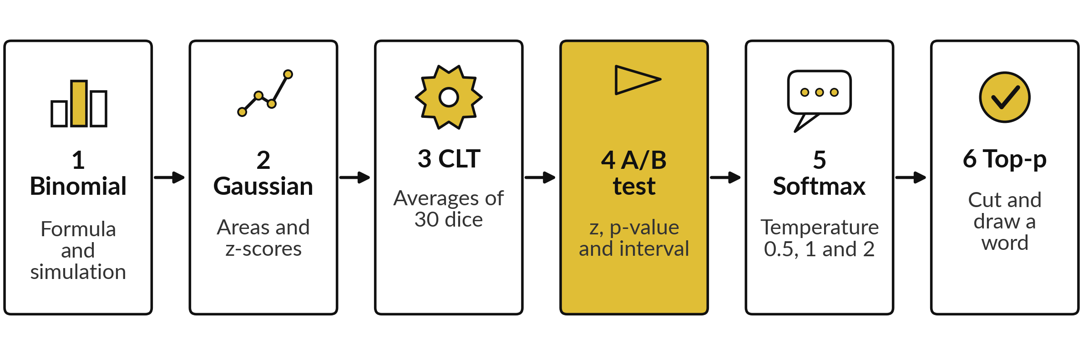
The lab has six stages, in
Python and in the spreadsheet
Python notebook: Session 14. Workbook sheets: Binomial, Normal, Sampling, ABtest and Temperature. Predict, run, read, change one thing.
Notes:
Here is the lab plan. Stage one, the binomial by formula and by simulation. Stage two, areas under the Gaussian. Stage three, the central limit theorem with averages of thirty dice. Stage four, the A/B test with its z statistic, p-value and interval. Stage five, softmax with temperature on the toy logits.
Stage six, the top-p cut and drawing words. The workbook has one sheet per stage, with gold cells for you to fill. The Check sheet or the last notebook cell shows which answers are right.

Slide 32
Check your numbers against
these before you move on
What you compute | You should see
Binomial(10, 0.3): P(X = 3) by formula | 0.2668
Normal(60, 10): P(X < 75) and P(50 < X < 70) | 0.9332 and 0.6827
Standard error of the mean of 30 dice: formula, and simulated (seed 14) | 0.3118; about 0.311
Confidence interval of the 60 fixed rolls | 3.515 to 4.418
A/B test: pooled rate, z, two-sided p-value | 0.13, 2.060, 0.0394
A/B test: 95% interval for the gap | 0.0010 to 0.0390
P(tea) at T = 0.5, 1 and 2 | 0.6278, 0.4459, 0.3252
Top-p 0.8: renormalised P(tea) | 0.4992
Simulated numbers use the seeds in the notebook. They match the slides only if the seed line runs first.
Notes:
Use this table as your checkpoint. The first rows come from formulas, and they must match exactly. The simulated numbers, such as the standard deviation of the averages, will be close to the table but are tolerant in the checks. The A/B test row is the one to look at twice: z of 2.06 and a p-value of 0.039.
If a number differs, stop and call me over, because every later step builds on the earlier ones.

Slide 33

Errors you will meet, what
they mean and what to do
Where | What you see | What to do
Python | Your sample numbers differ from the slides | Use Run all from the top. Every random step makes its own seeded generator.
Python | p-value 0.0197 instead of 0.0394 | You used one tail. Double the tail area for a two-sided test.
Spreadsheet | BINOM.DIST gives P(X at most 3) = 0.6496 | The last argument was TRUE. Use FALSE for exactly 3.
Spreadsheet | NORM.DIST #VALUE! | It needs four arguments: x, mean, standard deviation and TRUE.
Both | Probabilities after temperature do not add to 1 | The sum must run over all five words, with the same T in every term.
Notes:
Here are the errors you will probably meet. If your simulated numbers differ from the slides, check that the seeded generator line ran first. A p-value of 0.0197 means you used one tail instead of two. In the spreadsheet, BINOM.DIST with TRUE gives the probability of at most three, not exactly three.
NORM.DIST needs four arguments. And if the temperature probabilities do not add to one, the sum in the denominator is missing a word or uses a different T. Read the message and the formula first.

Slide 34
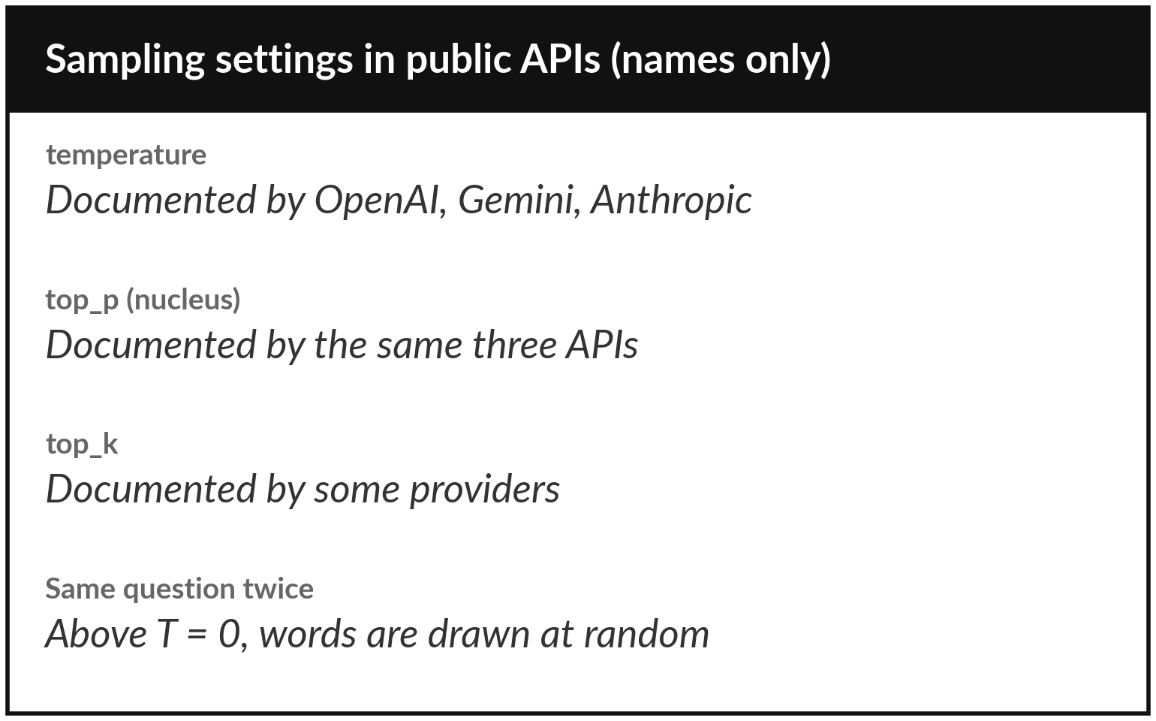
Where this appears in AI: temperature
and top-p are settings you can choose
These settings control the sampling you did by hand today.
Low temperature: steadier answers. High: more varied.
Nucleus sampling: Holtzman and colleagues, 2020.
Only for models that expose these settings. Products may add steps we cannot see.
Notes:
This is where today appears in real tools. The public APIs of OpenAI, Google Gemini and Anthropic all document a temperature setting and a top-p setting, and some providers document top-k as well. These are the knobs you just used. The model computes the probability for every token, the settings reshape and trim the list, and one token is drawn at random.
That randomness is why the same question can give different answers. What a product does beyond these settings is not public, so I will not claim more. Do you now see why low temperature repeats itself?

Slide 35
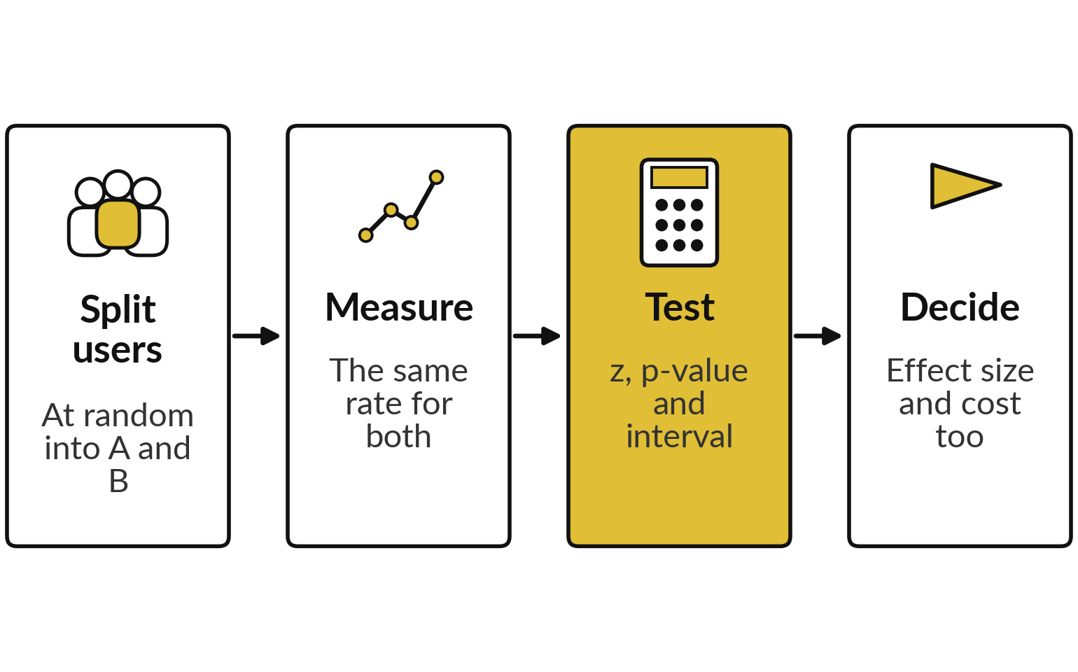
Where this appears in AI: an A/B test shows
whether a new AI feature really is better
Online experiments compare two versions of a product on one measured rate.
Published practice: Kohavi, Tang and Xu describe it in their 2020 book on online controlled experiments.
The mathematics is the same as today. Which AI features a company tests is its own business.
Notes:
Here is the same mathematics in practice. Teams that build products with language models compare versions with online experiments. They split users at random, measure one rate such as helpful ratings, and run the same test you ran today. The method is published, for example in the 2020 book by Kohavi, Tang and Xu on online controlled experiments.
We do not know which features a specific company tests, so I make no claim about that. The decision also weighs the size of the effect and the cost, as well as the p-value.

Slide 36
Where this appears in AI: check
an assistant with your numbers
8 minutes
Check an AI assistant
Ask an AI assistant to run the A/B test on our made-up counts.
You keep
A note: its numbers, your numbers, and any misreading you spotted.
Give it A: 288 of 2,400 and B: 336 of 2,400.
Ask for z, p and a 95% interval.
Compare with 2.06, 0.039 and 0.1 to 3.9 points.
Ask what p means. Look for misreadings.
Notes:
Now a short activity. Give any AI assistant our A and B counts and ask for the z statistic, the two-sided p-value and a 95 percent interval for the gap. Compare with our numbers: z of 2.06, p of 0.039, and an interval of 0.1 to 3.9 percentage points.
Then ask it to explain the p-value in plain words, and see whether it slips into one of the misreadings. Use only made-up data like this, never confidential data.

Slide 37
Exit check: three questions
Question | Short answer
A fair coin is flipped 10 times. What are the mean and standard deviation of the number of heads? | n p = 5 and the square root of 10 × 0.5 × 0.5, which is 1.581.
A test gives p = 0.03. Does that mean a 3% chance the feature does nothing? | No. It is the chance of a gap this large if there is truly no difference.
What does lowering the temperature do to the next-word probabilities? | It makes them sharper: the top word gets more probability, and the answers repeat more.
Notes:
Three questions to finish. First, ten fair coin flips: the mean number of heads is n times p, which is five, and the standard deviation is the square root of 10 times 0.5 times 0.5, about 1.58. Second, a p-value of 0.03 does not mean a three percent chance that the feature does nothing.
It is the chance of a gap this large if there is truly no difference. Third, lowering the temperature sharpens the probabilities, so the top word gets more, and answers repeat more. Write your answers in your lab file.

Slide 38
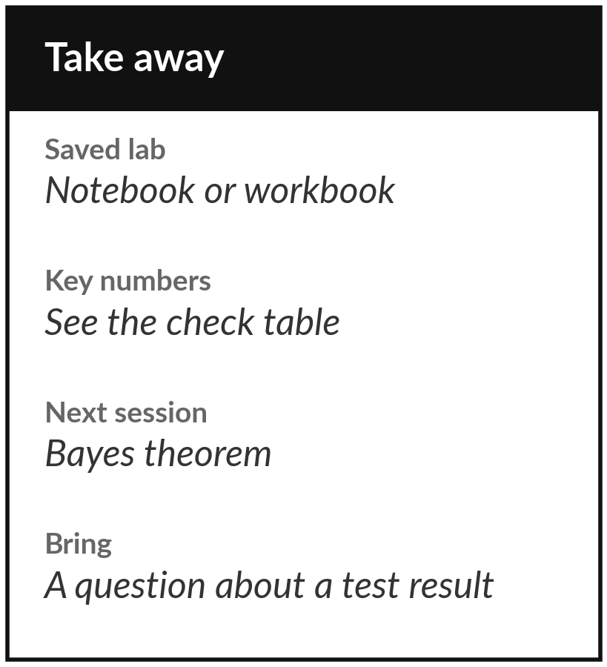
Save the lab and keep your key numbers
What you keep from today
Keep your saved lab and these numbers: binomial P(X = 3) = 0.2668, normal P(X < 75) = 0.9332, A/B test z = 2.06 and p = 0.039, and the three softmax rows for T = 0.5, 1 and 2.
Our question today
Why can the same question get a different answer from a chat model, and how do we test whether a new AI feature is better?
Next session
Session 15: conditional probability and Bayes. We update beliefs with evidence and build a small spam filter by hand.
Notes:
Before you go, save your notebook or workbook and keep the key numbers from the check table. Next session is conditional probability and Bayes. We will update a belief when new evidence arrives, work through a medical test with natural frequencies, and build a small spam filter by hand.
If a p-value or a confidence interval is still unclear, write down your question and bring it.
We began with this question: Why can the same question get a different answer from a chat model, and how do we test whether a new AI feature is better? Before you go, say in one sentence what you can now say about it.

